Slide 1
Computer vision fundamentals

Slide 2
Unit objectives
Describe image representation for computers.
Describe the computer vision (CV) pipeline.
Describe different preprocessing techniques.
Explain image segmentation.
Explain feature extraction and selection.
Explain image classification.

Slide 3
Topics
Image representation
Computer vision pipeline

Slide 4
Image representation

Slide 5
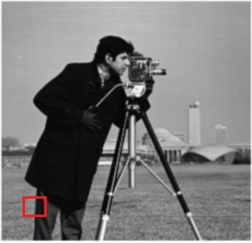

Image representation
Images are stored as a 2D array of pixels on computers.
Each pixel has a certain value that represent its intensity.
Example of grayscale representation:
Image is black and white with shades of gray in between.
Pixel intensity is a number between 0 (black) and 255 (white).
int[ ][ ] array = { {255, 170, 170, 0},
{220, 80, 80, 170},
{255, 80, 0, 0},
{175, 20, 170, 0} };
Notes:
It is important to understand how images are stored and represented on computer screens. Images are made of grids of pixels, that is, a two-dimensional (2D) array of pixels, where each pixel has a certain value that represents its intensity. A pixel represents a square of color on the user’s screen. Colors can be represented in image in various ways.
If the image is grayscale, that is, black and white with shades of gray in between, the intensity is a number in the range 0 - 255, where 0 represents black and 255 represents white. The numbers in between these two values are different intensities of gray.
For example, in the picture in the slide, assume that you selected a small square from the image (the part in the red square). The pixel representation for it is in black, white, and shades of gray. To the right of the picture is the numeric values of these pixels in a 2D array.
┌ Note ─────────────────
The 256 scaling is a result of using 8-bit storage (2⁸ =256).
└────────────────────
References:
Data Representation
https://www.csfieldguide.org.nz/en/chapters/data-representation/
Colour Models
https://www.sqa.org.uk/e-learning/BitVect01CD/page_36.htm
Image reference
https://www.mathworks.com/help/examples/images/win64/SegmentGrayscaleImageUsingKMeansClusteringExample_01.png

Slide 6
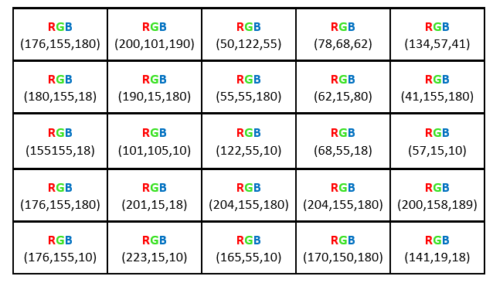
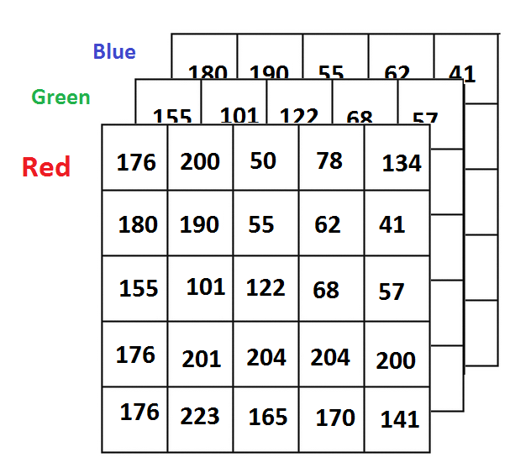
Image representation (cont.)
Example of color representation:
The pixel color is represented as a mix of Red, Green, and Blue.
The pixel intensity becomes three 2D arrays or one 2D array, where each entry is an object containing the 3 color values of RGB
three 2D array
one 2D array
Notes:
Many color models are available for colored images. The best-known model is RGB, where the color of the pixels is represented as a mix of Red, Blue, and Green color channels. The value of the pixel intensity is represented as three 2D arrays that represent the three color channels, where each color value is in the range 0 – 255. The color value represents different intensities of the colors and all the colors that you see on the screen. The number of color variations that are available in RGB is 256 * 256 *256 = 16,777,216 possible colors.
Depending on the data structure used that image appears as
Three 2D arrays, where each 2D array represents the values and intensities for one color. The image is a combination of all three arrays.
One 2D array, where each entry in the array is an object that contains three color values of RGB.
References:
Data Representation
https://www.csfieldguide.org.nz/en/chapters/data-representation/
Colour Models
https://www.sqa.org.uk/e-learning/BitVect01CD/page_36.htm
How MATLAB Represents Pixel Colors
https://www.mathworks.com/company/newsletters/articles/how-matlab-represents-pixel-colors.html

Slide 7
Computer vision pipeline

Slide 8
Computer vision pipeline
The steps and functions that are included are highly dependent on the application.
Here is a conventional visual pattern recognition pipeline.
Image Acquisition
Pre-Processing
Segmentation
Feature Extraction & Selection
Classification
Notes:
The steps and functions that are included in a CV system algorithm pipeline are highly dependent on the application. The application might be implemented as a stand-alone part of a system and might apply to only a certain step of the pipeline, or it can be a larger application, that is, an end-to-end application that takes certain images and then applies all of the steps and functions in the pipeline.
Reference:
Hardware Architecture for Real-Time Computation of Image Component Feature Descriptors on a FPGA
https://www.researchgate.net/publication/273596152_Hardware_Architecture_for_Real-Time_Computation_of_Image_Component_Feature_Descriptors_on_a_FPGA

Slide 9
Computer vision pipeline (cont.)
Image acquisition:
The process of acquiring images and saving them in a digital image format for processing.
Images often use common formats, such as .jpeg, .png, and .bmp.
Images are 2D images that are stored as arrays of pixels according to their color model.
Notes:
Image acquisition
Image acquisition is the process of acquiring images and saving them in a digital image format for processing in the pipeline.
Images are acquired from image sensors, such as commercial cameras. Other types of light-sensitive devices can be used to capture different types of images. Other image sensors include radar, which uses radio waves for imaging.
Depending on the type of the device, the captured image can be 2D, 3D, or a sequence of images. These images often use common formats, such as .jpeg, .png, and .bmp.
Images are stored as arrays of pixels according to their color model.
Reference:
System methods
https://en.wikipedia.org/wiki/Computer_vision#System_methods

Slide 10
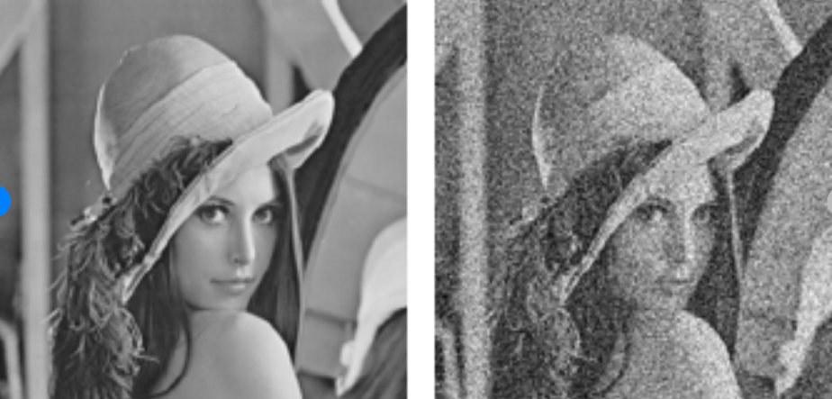
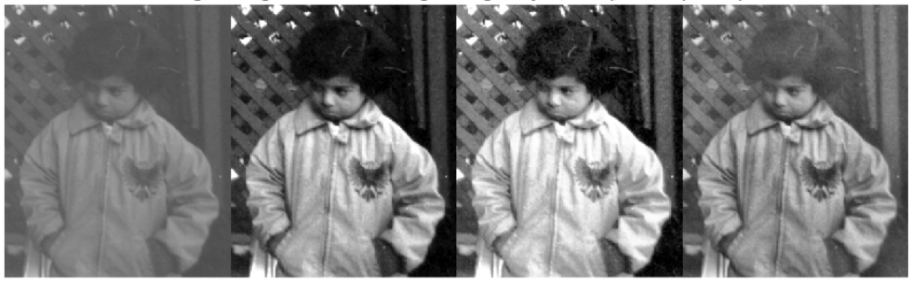
Computer vision pipeline (cont.)
Pre-processing:
Preparing the image for the processing stage
Examples:
Resizing images
Noise reduction
Contrast adjustment
Notes:
Pre-processing:
This stage focuses on preparing the image for the processing stage.
Examples:
Images are resized as a form of normalization so that all images are the same size.
Noise reduction reduces noise that represents false information in the image, as shown in the slide.
Contrast adjustment helps with the detection of image information. In the images of the little girl, each image represents a different contrast adjustment.
Image source: https://www.mathworks.com/help/images/contrast-adjustment.html
Reference:
System methods
https://en.wikipedia.org/wiki/Computer_vision#System_methods

Slide 11
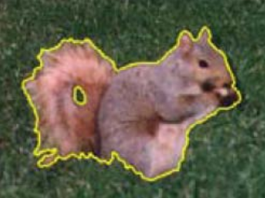
Computer vision pipeline (cont.)
Segmentation:
Partitioning an image into regions of similarity.
Grouping pixels and features with similar characteristics together.
Helps with selecting regions of interest within the images. These regions can contain objects of interest that you want to capture.
Segmenting an image into foreground and background.
(Cremers, Rousson, and Deriche 2007) © 2007 Springer
Notes:
Segmentation
The position of the image segmentation phase is not fixed in the CV pipeline. It might be a part of the pre-processing phase or follow it or be part of the feature extraction and selection phase or follow them.
Segmentation is one of the oldest problems in CV and has the following aspects:
Partitioning an image into regions of similarity.
Grouping pixels and features with similar characteristics together.
Helps with selecting regions of interest within the images. These regions can contain objects of interest that you want to capture.
Segmenting an image into foreground and background to apply further processing on the foreground.
Image citation: Cremers, D., Rousson, M., & Deriche, R. (2007). A review of statistical approaches to level set segmentation: integrating color, texture, motion and shape. International journal of computer vision, 72(2), 195-215.
References:
Computer vision
https://en.wikipedia.org/wiki/Computer_vision
Computer Vision: Algorithms and Applications
http://www.cs.ccu.edu.tw/~damon/tmp/SzeliskiBook_20100903_draft.pdf
Segmentation of Images
http://www.cse.iitm.ac.in/~vplab/courses/CV_DIP/PDF/lect-Segmen.pdf

Slide 12
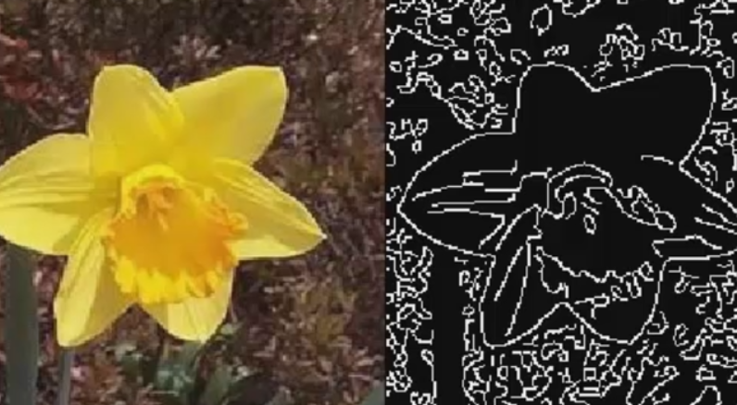
Computer vision pipeline (cont.)
Feature extraction and selection:
Find distinguishing information about the image.
Image features examples: distinct color in an image or a specific shape such as a line, edge, corner, or an image segment.
Notes:
Feature extraction and selection
In computer vision, a feature is a measurable piece of data in your image, which is unique to this specific object. It can be a distinct color in an image or a specific shape such as a line, edge, corner, or an image segment. A good feature is used to distinguish objects from one another.
The objective is to transform the raw data (image) into a features vector so that the learning algorithm learns the characteristics of the object.
Typical examples of such features are:
Lines and edges: These features are where sharp changes in brightness occur. They represent the boundaries of objects.
Corners: These features are points of interest in the image where intersections or changes in brightness happens.
These corners and edges represent points and regions of interest in the image.
Brightness in this context refers to changes in the pixel intensity value.
References:
Computer Vision Pipeline, Part 1: the big picture
https://freecontent.manning.com/computer-vision-pipeline-part-1-the-big-picture/
The Computer Vision Pipeline, Part 4: feature extraction
https://freecontent.manning.com/the-computer-vision-pipeline-part-4-feature-extraction/
Detection
https://en.wikipedia.org/wiki/Feature_(computer_vision)#Detectors
Edge Detection
https://www.mathworks.com/discovery/edge-detection.html
Computer vision
https://en.wikipedia.org/wiki/Computer_vision
Image reference: https://www.mathworks.com/discovery/edge-detection.html

Slide 13



Computer vision pipeline (cont.)
Some extracted features might be irrelevant or redundant.
Feature selection follows feature extraction.
Feature selection is choosing a feature subset that can reduce dimensionality with the least amount of information loss.
All Features
Selection
Techniques
Selected
Features
Notes:
For feature extraction, all the features in the image that could be extracted are present. Now, start selecting the features that are of interest. Some extracted features might be irrelevant or redundant.
Here are some reasons to perform feature selection:
Reduce the dimensions of the features that were extracted from the image.
Avoid overfitting when training the model with the features.
Create simpler models with less training time.
References:
Feature selection
https://en.wikipedia.org/wiki/Feature_selection
Application of high-dimensional feature selection: evaluation for genomic prediction in man
https://www.nature.com/articles/srep10312

Slide 14
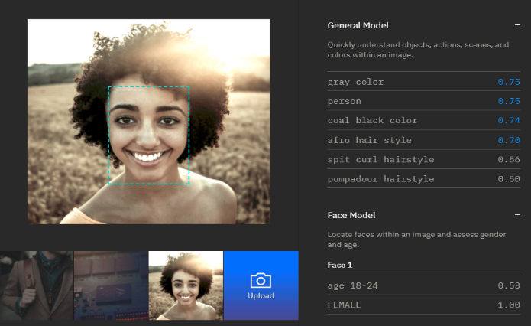
Computer vision pipeline (cont.)
Classification:
The extracted features are used to classify the image.
More processing might be done on the classified images to identify more features from the image.
Example: After face detection, identify features on the face, such as hair style, age, and gender.
Notes:
Classification: Image classification is a practice in computer vision. It focuses on classifying an image according to its visual content.
Further processing is done on the classified images to identify more features from the image. For example, after the image is classified to detect the face region, identify features on the face such as hair style, age, and gender.
Reference:
Image Classification
https://www.sciencedirect.com/topics/computer-science/image-classification

Slide 15
Decision making
Apply logic to make decisions based on detected images.
Examples:
Security application: Grant access based on face recognition.
In a greenhouse environment, a notification is sent to the engineers to act if a plant is detected as suffering from decay.
Notes:
Decision making
After getting the output from the CV pipeline, users can apply logic that is based on the findings to make decisions based on detected images.
For example, in security applications, the system can decide to grant access to a person if a face that is detected is identified as the owner of a facility.
Another example is in a greenhouse environment, where a notification is sent to the engineers to act if a plant is detected as suffering from decay.

Slide 16
Unit summary
Describe image representation for computers.
Describe the computer vision (CV) pipeline.
Describe different preprocessing techniques.
Explain image segmentation.
Explain feature extraction and selection.
Describe when object recognition takes place.

Slide 17

Review questions
True or False: There is only one model to represent color in images, which is the RGB color model.
True or False: In feature extraction, one of the reasons to perform feature selection is to avoid overfitting when training the model.
True or False: In a CV pipeline, classification deals with extracting a measurable piece of data in your image.
Which of the following items is not an example of feature extraction:
Shape
Color
Lines and edges
Noise

Slide 18

Review answers
True or False: There is only one model to represent color in images, which is the RGB color model.
True or False: In feature extraction, one of the reasons to perform feature selection is to avoid overfitting when training the model.
True or False: In the CV pipeline, classification deals with extracting a measurable piece of data in your image.
Which of the following items is not an example of feature extraction:
Shape
Color
Lines and edges
Noise

Slide 19
Exercise: Using a basic deep neural network to solve an image recognition problem

Slide 20
Exercise objectives
In this exercise, you use a simple deep neural network to solve an image recognition problem. Here, the focus is more on the overall technique and use of a library than on perfecting the model.
After completing this exercise, you should be able to:
Perform image recognition tasks by using deep learning.
Use Tensorflow and Keras libraries.
Prepare and preprocess an image data set.
Visualize data.
Build, compile, and train a neural network.
Make predictions and test a model.

